Slide 1
Introducing Inferential Statistics:
T-test

Slide 2
INFERENTIAL STATISTICS
Descriptive statistics provide basic measures of a distribution of scores
Inferential statistics allow inferences to a larger population from the sample
used to determine the likelihood that a conclusion based on analysis of data from a sample is true.

Slide 3
THE IDEA OF STATISTICAL SIGNIFICANCE
Because sampling is imperfect
  Samples may not ideally match the population, and
Because hypotheses cannot be directly tested
  Inference is subject to error

Slide 4
STATISTICAL SIGNIFICANCE
The degree of risk that you are willing to take that you will reject a null hypothesis when it is actually true
p value: the probability that the groups really aren't different after all. By convention, a p value less than 0.05 is considered statistically significant.

Slide 5
HOW A TEST OF SIGNIFICANCE WORKS
Each type of null hypothesis is tested with a particular statistic
Each statistic is characterized by a unique distribution of values that are used to evaluate the sample data

Slide 6
USING A STATISTICAL TEST
State the null hypothesis
  H_{o}: µ ₁ = µ₂
Establish significance level
  e.g., p = 0.05
  e.g., p = 0.01

Slide 7
USING A STATISTICAL TEST
Select appropriate test statistic
Compute test statistic (obtained value)
Determine value needed to reject null (critical value), which depends on
  Level of significance chosen (e.g., p = 0.05)
  Degrees of freedom (based on sample size)
Compare values
If p-value > critical value, accept null
If p-value ≤ critical value, reject null

Slide 8
T-Tests
One Sample T-test:
To test if a sample comes from a population with a particular mean. One sample t-test is a statistical procedure used to examine the mean difference between the sample and the known value of the population mean. In one sample t-test, we know the population mean. We draw a random sample from the population and then compare the sample mean with the population mean and make a statistical decision as to whether or not the sample mean is different from the population mean.
2-Independent T-test: (Two independent population means are equal)
A t-test helps you compare whether two groups have different average values (for example, whether men and women have different average heights).
Paired T-test: (Two related population means are equal)
Paired sample t-test is a statistical technique that is used to compare two population means in the case of two samples that are correlated. Paired sample t-test is used in ‘before-after’ studies, or when the samples are the matched pairs, or when it is a case-control study.

Slide 9
t-TEST FOR INDEPENDENT MEANS
Used to test null hypothesis when two independent, unrelated groups are compared.
Example: Blood pressure among students
Assume that a study has been conducted whereby 5 students were randomly selected from Year 1 and Year 2 each and their BP were measured.

Slide 10
t-TEST FOR INDEPENDENT MEANS
Assumptions:
  The observations in the two categories must be independent.
  Normally distributed.
  Sample is large enough (> 30)

Slide 11
t-TEST FOR INDEPENDENT MEANS
Hypothesis (null): There is no difference between the means of the groups from Y1 and Y2.
  Mean Y1 == Mean Y2
Hypothesis (a): There is a difference between the means of the groups from Y1 and Y2.
  Mean Y1 != Mean Y2

Slide 12
t-TEST FOR INDEPENDENT MEANS
Assume that when t-test is done, the p-value obtained is 0.03.
Since p-value < 0.05, so we reject the null hypothesis and conclude that there is a difference between the means of the groups from Y1 and Y2

Slide 13
SPSS example
Teacher satisfaction in public and private schools
Public Private
4 9
4 8
6 10
8 8
8 10
M=6 M=9
By looking at the means, we can conclude that private teachers are more satisfied than public. But are they significantly different?

Slide 14
SPSS example
Teacher satisfaction in public and private schools
Public Private
4 9
4 8
6 10
8 8
8 10
M=6 M=9
By looking at the means, we can conclude that private teachers are more satisfied than public. But are they significantly different?

Slide 15
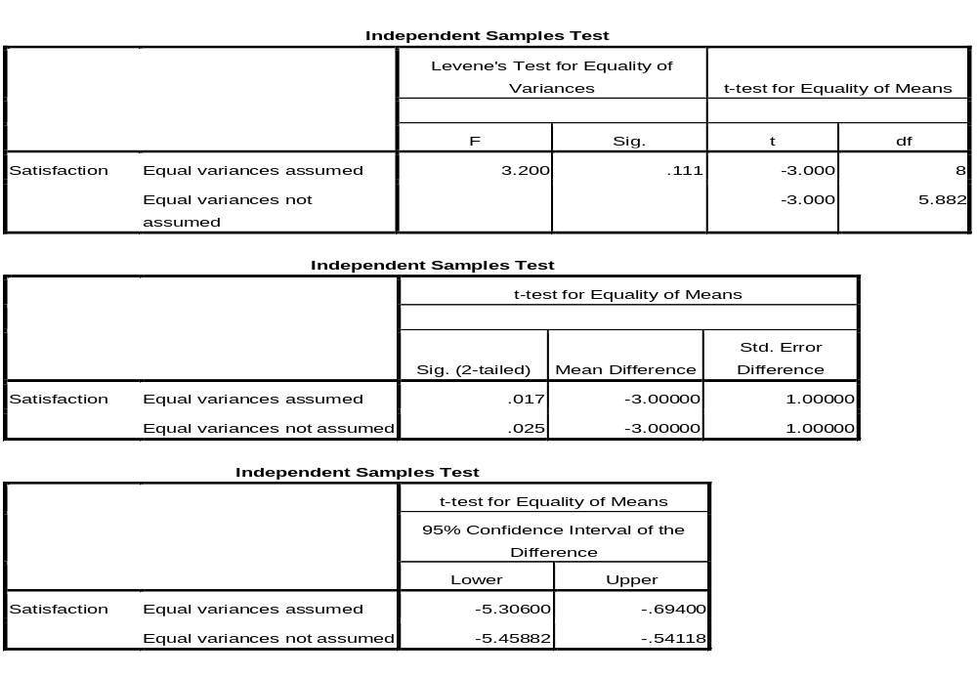
SPSS example
Teacher satisfaction in public and private schools
P-value is less than 0.05, so satisfaction between the groups were significantly different.

Slide 16
Exercises: Watch this video (on the YouTube).
i) One Sample T-test:
https://www.youtube.com/watch?v=2zVeV1ohGCU
ii) 2-Independent T-test:
https://www.youtube.com/watch?v=oIpzdTc0reI
iii) Paired T-test:
https://www.youtube.com/watch?v=Qt-TlsY_b3k

